Slide 1
Physiology of Ageing
Date: 08-10-2025
Dr. Yerra Vishnu Akhil Raj Kumar
Senior Resident, AIIMS Bibinagar
MBBS- AIIMS Patna
Bio-Design Fellow- IIT Hyderabad
MD Physiology- AIIMS Raipur

Slide 2
Contents
Case Scenarios
Aging- systems wise
Theories of Ageing
Recent Advances

Slide 3
Case Scenarios

Slide 4
Case 1:
A 72-year-old retired teacher presented with complaints of gradual forgetfulness and increasing difficulty in recalling recent events. Over the past year, his family noted that his response time has slowed and his walking pace has become more deliberate. On examination, he was found to have mild tremors and a slightly stooped posture. His long-term memory remained intact, but his reaction time was reduced compared to previous years.

Slide 5
What cellular and molecular mechanisms explain the decline in short-term memory with preserved long-term memory in ageing brains?
How does oxidative stress and mitochondrial dysfunction contribute to slower reaction times in the elderly?
What role does dopamine depletion and basal ganglia changes play in producing tremors and stooped posture with age?
How does telomere shortening in neurons differ in impact compared to tissues with high mitotic activity?

Slide 6
Case 2:
A 68-year-old farmer reported experiencing fatigue on exertion and ankle swelling that worsened by the evening. He had no complaints of breathlessness at rest, and his urine output was within normal limits. On examination, his blood pressure was recorded as 150/90 mmHg, and mild pedal edema was present. Laboratory investigations revealed a slightly elevated serum creatinine, though overall urinary function remained preserved.

Slide 7
How does arterial stiffening at the structural level (elastin loss, collagen deposition, cross-linking) lead to elevated systolic blood pressure in ageing?
What mechanisms explain reduced renal clearance in the elderly despite apparently normal urine output?
How does diastolic dysfunction arise at the myocardial level during senescence?
What role do cumulative oxidative damage and chronic low-grade inflammation (“inflamm-ageing”) play in vascular and renal ageing?

Slide 8
System wise age-related changes

Slide 9
Hematology

Slide 10
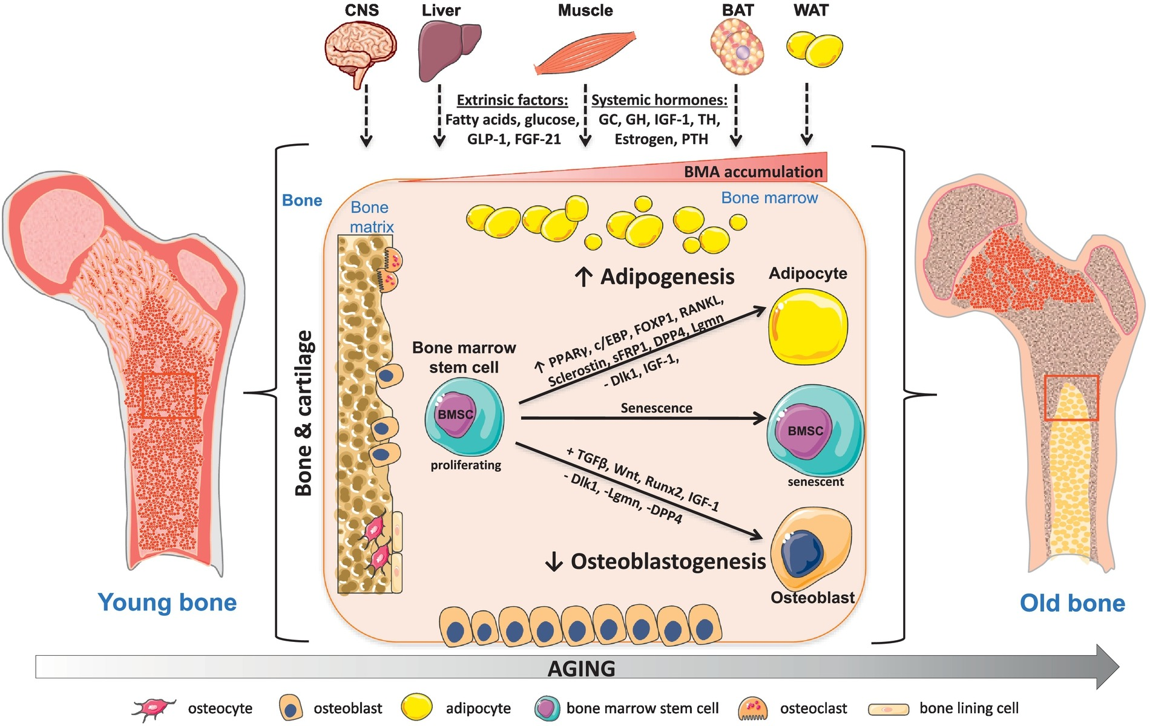
Bone marrow
Ref: https://doi.org/10.1016/j.bone.2019.03.041.

Slide 11
Immune system
Increase IL-6, CRP
T and B lymphocytes- Naive pool decreases
Memory cell increase
IgM and IgD levels decrease
CD8+ increase
CD4+ decrease
OVERALL DECREASE RESPONSE TO INFECTION AND VACCINATION

Slide 12
Respiratory system

Slide 13
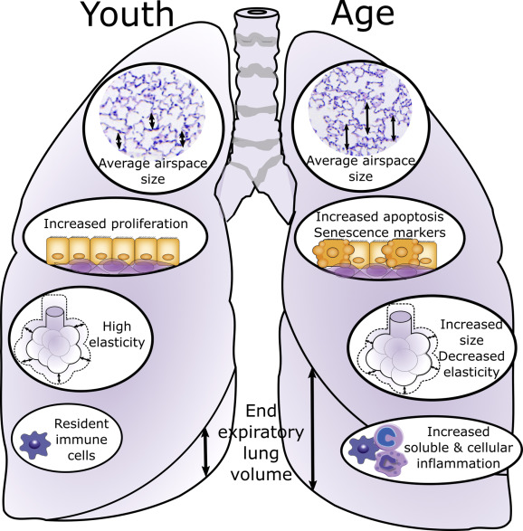
Ref: https://doi.org/10.1016/j.chest.2018.09.003

Slide 14
Overall changes in RS in old age
Decrease elasticity- Increase residual volume, decreases FEV1
Destruction of alveolar wall- Decrease surface are for diffusion of gases

Slide 15
Cardiovascular system

Slide 16
Fibrosis in heart- less compliance
Structural changes in valves- aortic stenosis, mitral valve incompetence
Decrease number of pacemaker cells
Collagen deposition in vessel wall
Endothelial dysfunction

Slide 17
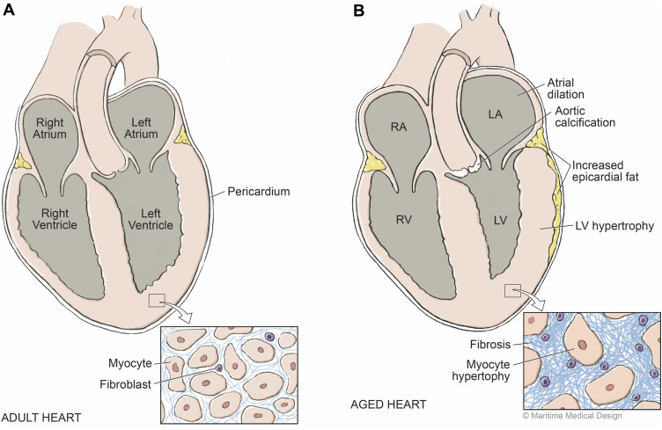
Ref: https://doi.org/10.1016/j.cjca.2016.03.017

Slide 18
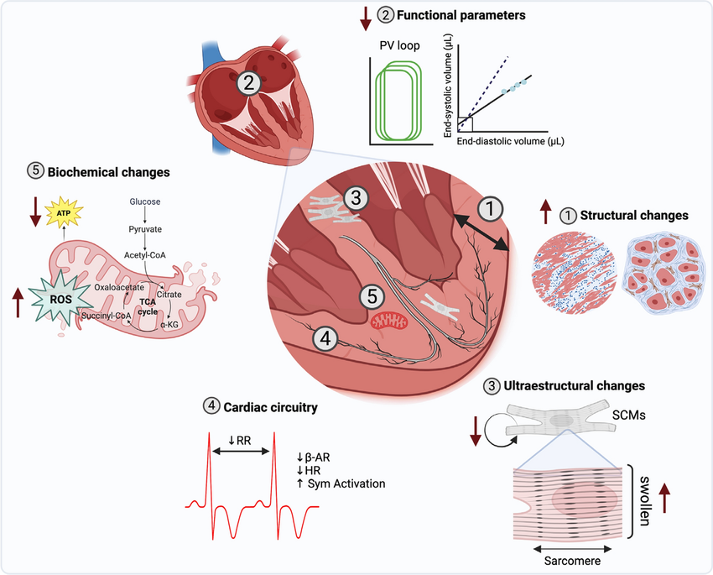

Slide 19
Gastrointestinal system

Slide 20
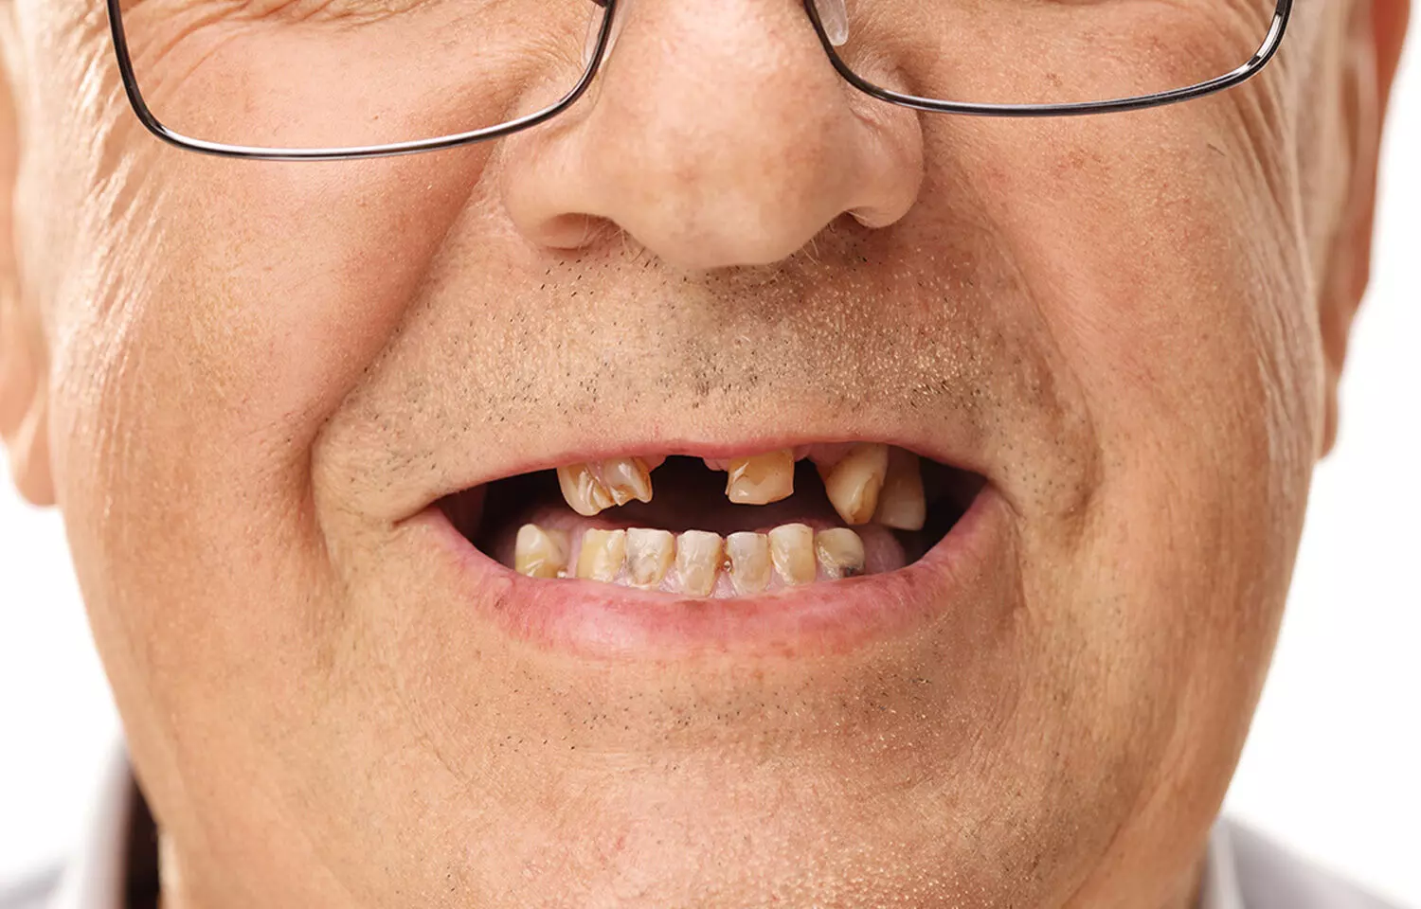
Teeth wear and tear

Slide 21
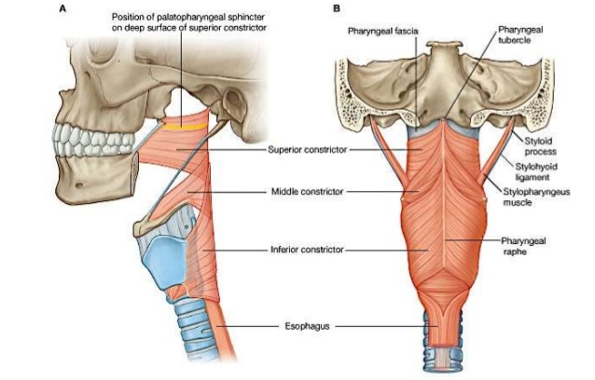
Weakness of Muscles causing dysphagia

Slide 22
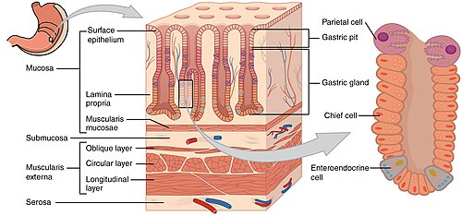
Gastric Gland atrophy and decrease gastric secretion

Slide 23
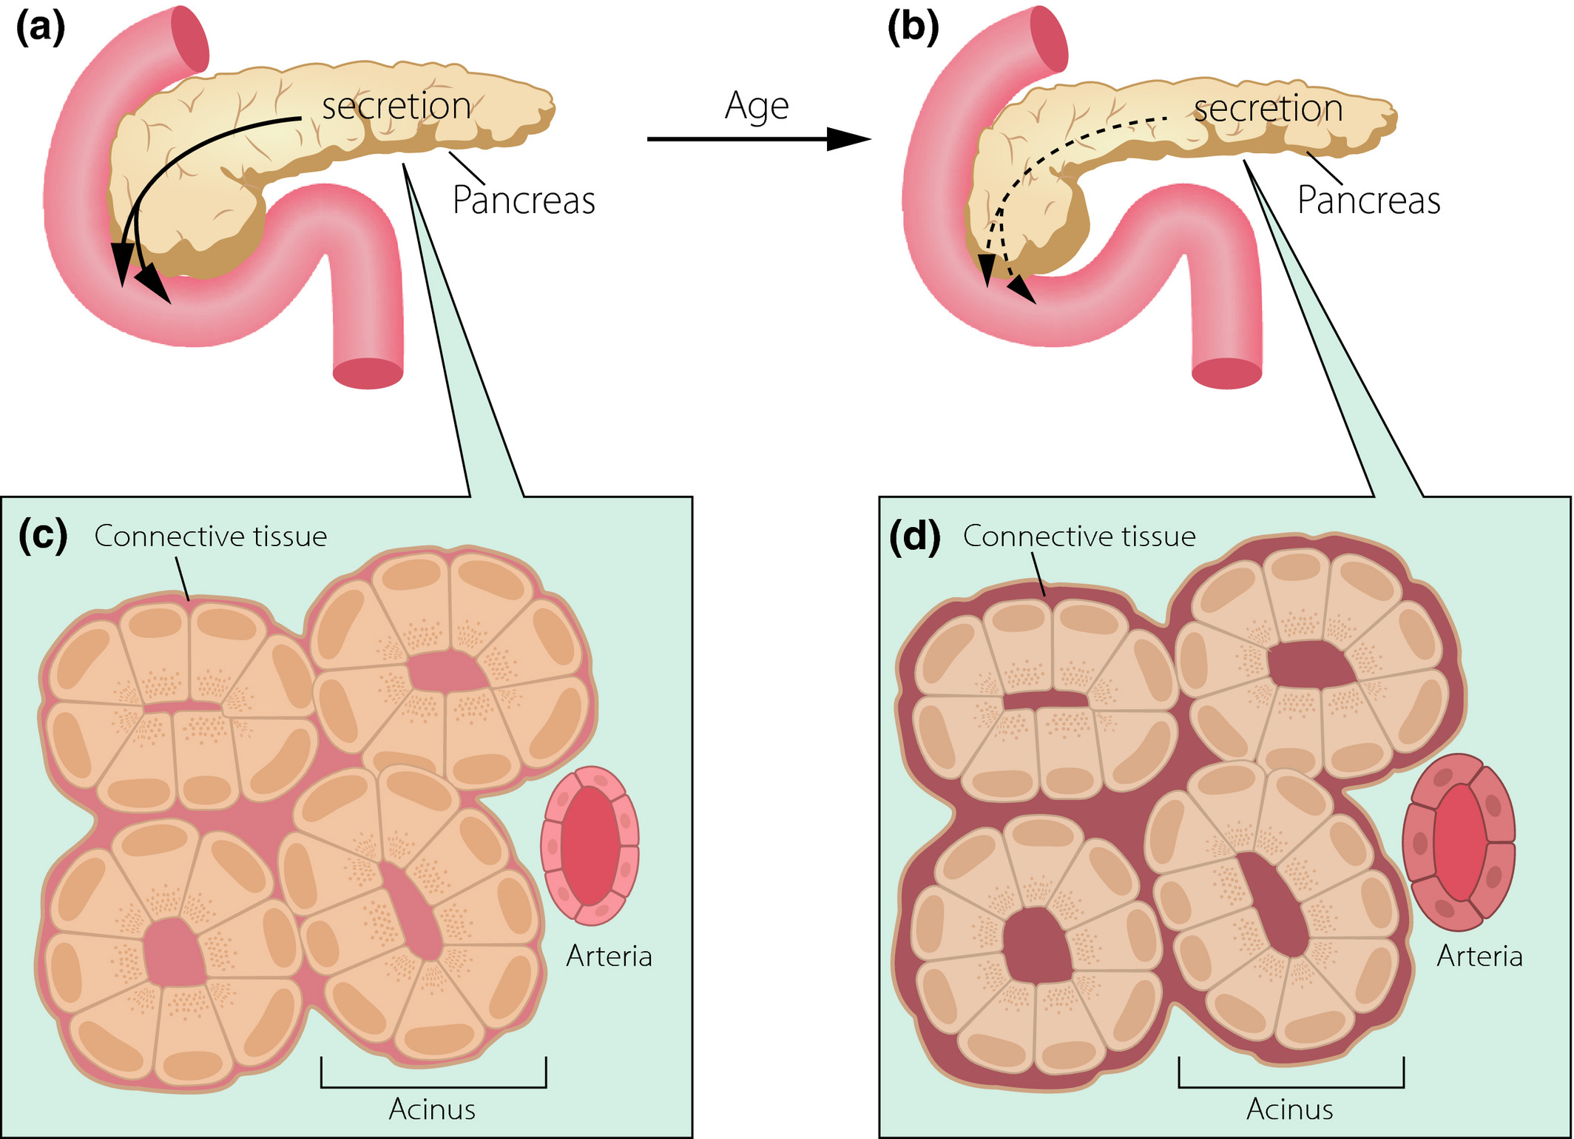
Ref: https://doi.org/10.1111/joim.12745

Slide 24
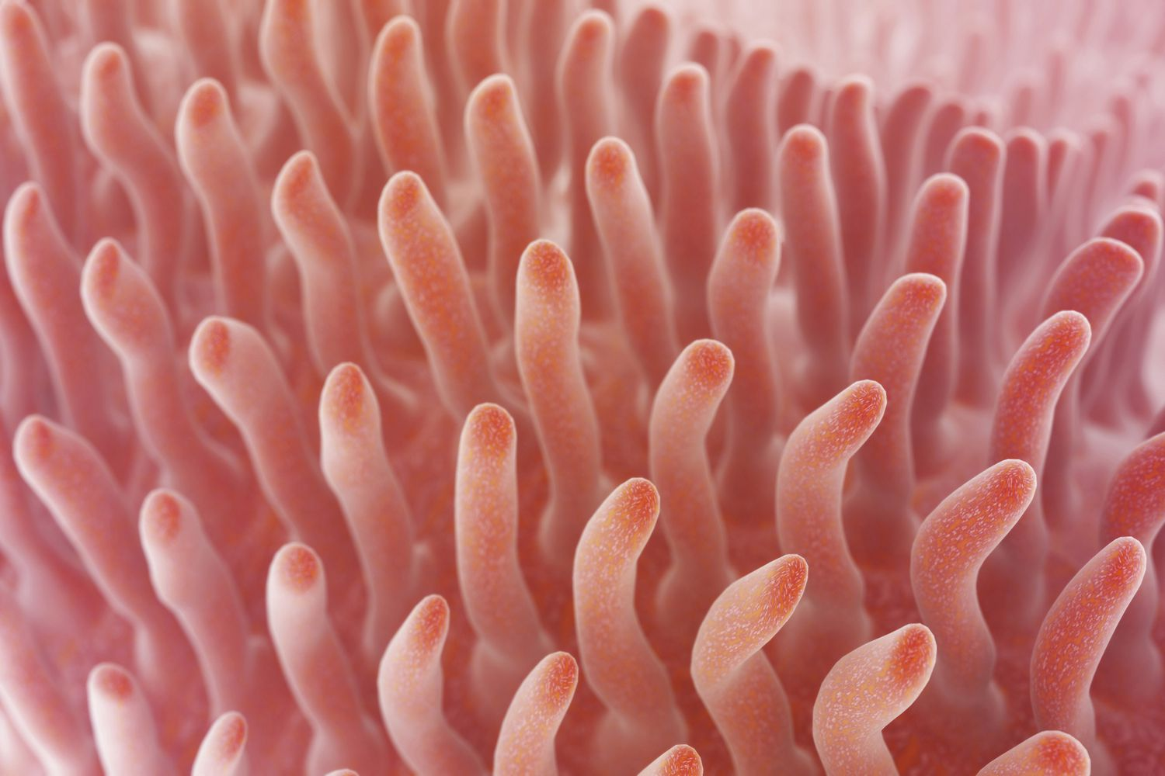
SMALL INTESTINE
Decrease in villus height causing decrease surface area

Slide 25
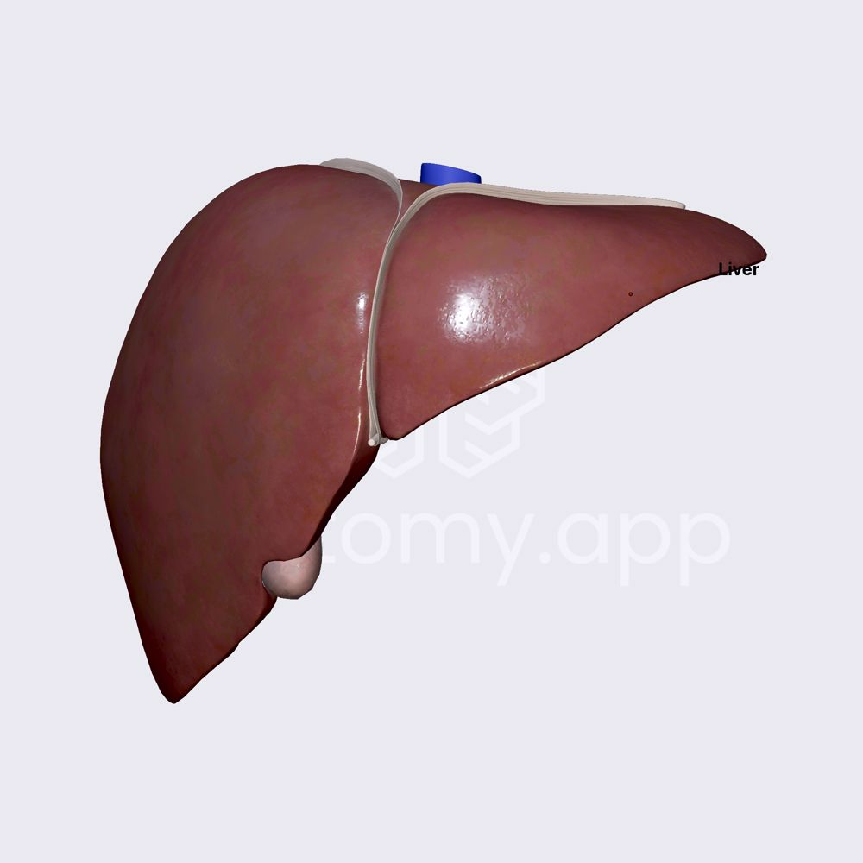
LIVER
Decrease in hepatocytes number
Fibrosis

Slide 26
Excretory system

Slide 27
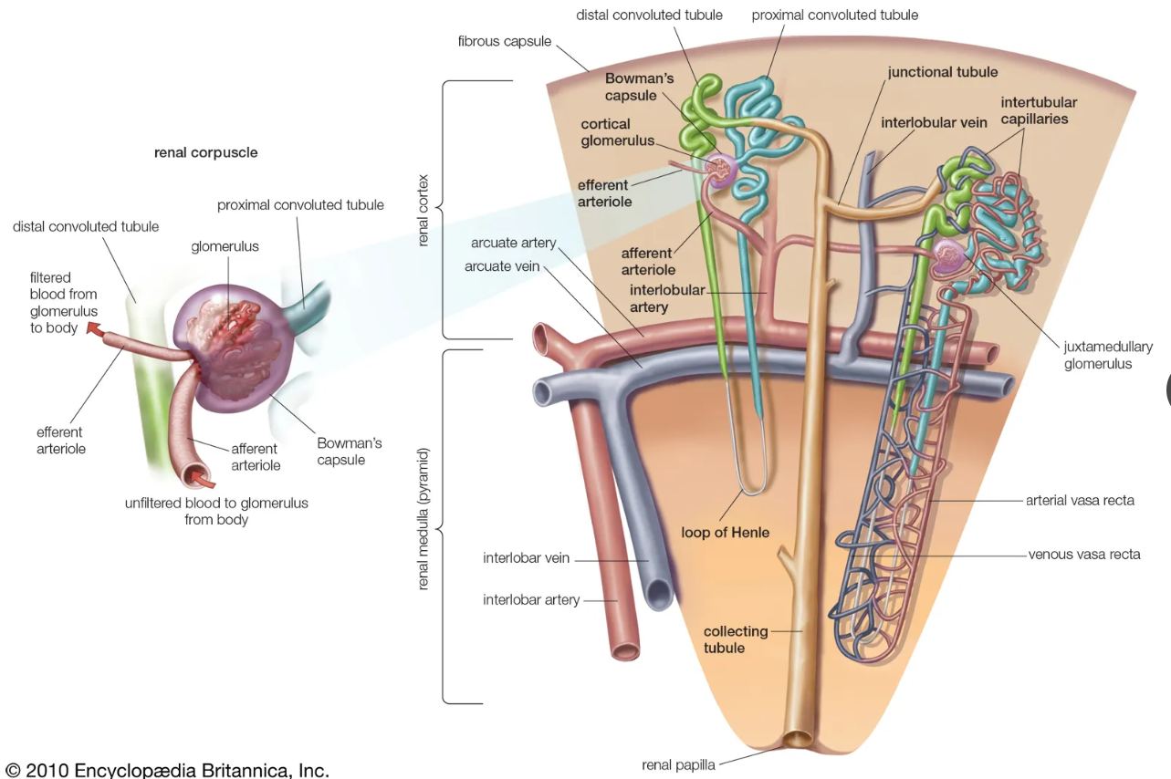
NEPHRONS
Decrease in number
Decrease in size
RENAL BLOOD SUPPLY
Decrease in supply
NEPHRONS
Thickening of filtration membrane

Slide 28
Endocrine system

Slide 29
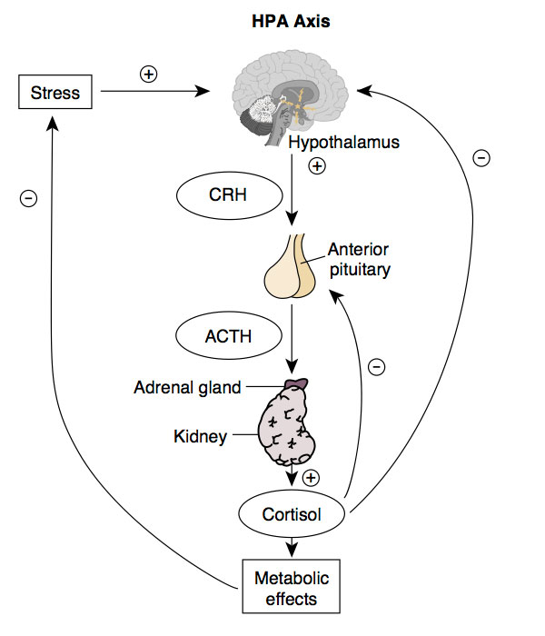
Decrease in response to stress

Slide 30
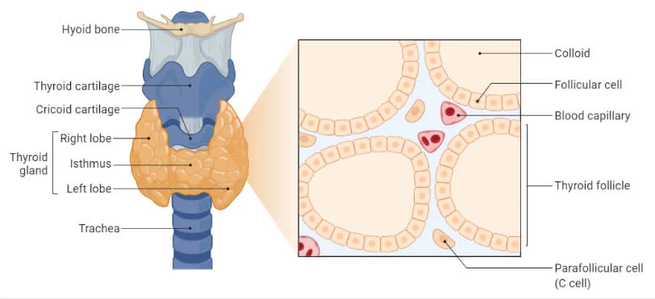
SECRETIONS
Decrease in T3 and T4

Slide 31
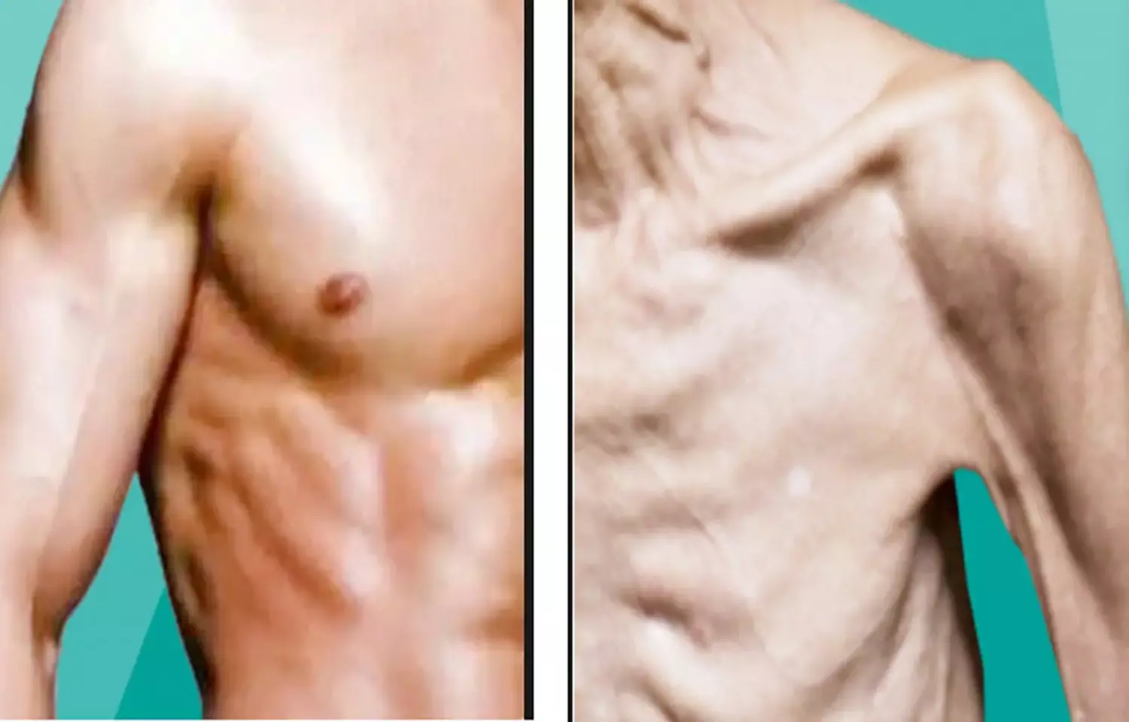
MUSCLE MASS
Decrease in muscle mass due to decrease in GH

Slide 32
Menopausal changes in women

Slide 33
Nervous system

Slide 34
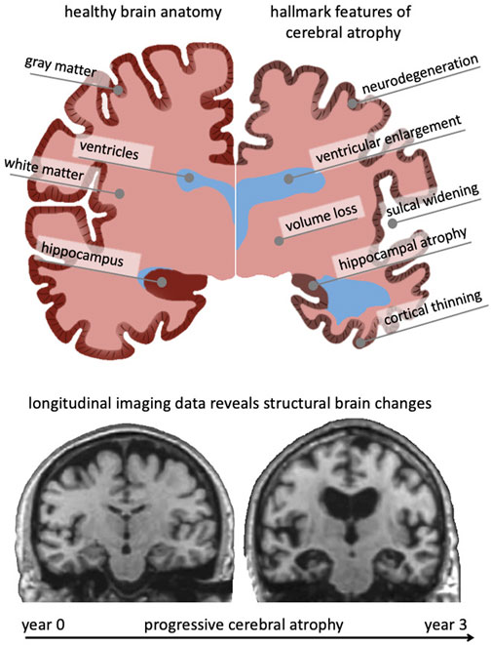
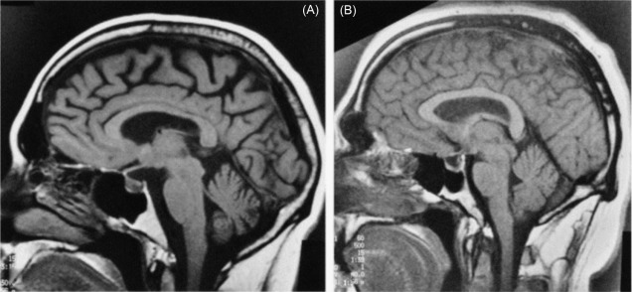
Ref: https://doi.org/10.3389/fmech.2021.705653

Slide 35
Impaired Temperature regulation
Postural Hypotension

Slide 36
Special Senses

Slide 37
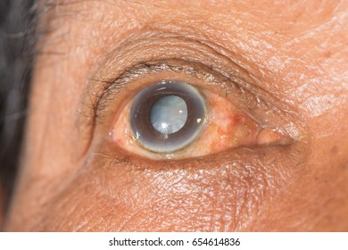
Senile cataract

Slide 38
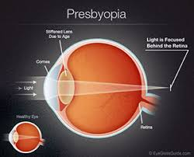

Slide 39
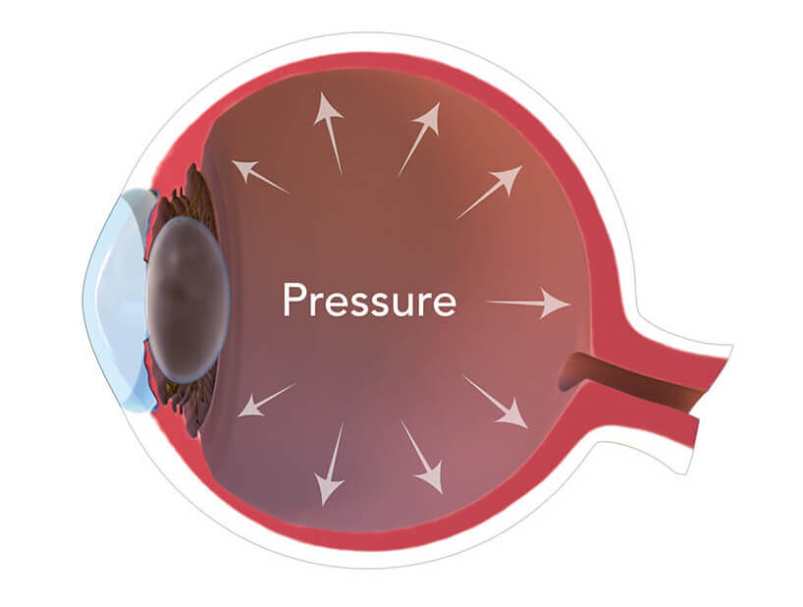
Intra Ocular Pressure rises

Slide 40
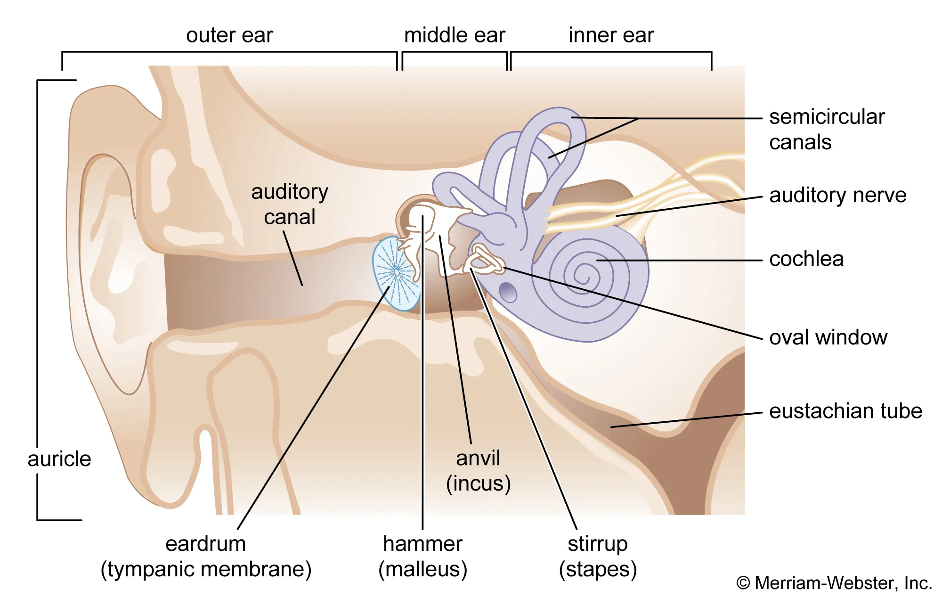
Presbyacusis
Loss of Neurons
Loss of Hair cells
Loss of tympanic membrane elasticity
Rigid middle ear bones

Slide 41
Theories of ageing

Slide 42
Theory | Scientist / Proponent | Content (Essence of the Theory) | Relevance to Ageing
Mutation Accumulation Theory | Peter Medawar (1952) | Harmful mutations expressed later in life accumulate because natural selection is weaker after reproductive age. | Explains why ageing-related diseases increase in later life (e.g., cancer, neurodegeneration).
Antagonistic Pleiotropy Theory | George C. Williams (1957) | Genes beneficial in early life (e.g., fertility, growth) may have harmful effects in later life (pleiotropy). | Provides evolutionary explanation for trade-off between reproduction and longevity.
Disposable Soma Theory | Thomas Kirkwood (1977) | Organisms allocate limited energy between reproduction and repair. Less energy is invested in somatic maintenance → ageing. | Explains why ageing is inevitable due to prioritization of reproduction over repair.
Nutrient Sensing Pathways | Cynthia Kenyon, Leonard Guarente (1990s) | Caloric restriction and pathways like insulin/IGF-1, mTOR, sirtuins regulate lifespan. | Links metabolism, diet, and molecular pathways to longevity. Basis for anti-ageing research.
Rate of Living Theory | Raymond Pearl (1928) | Lifespan inversely proportional to metabolic rate; faster metabolism → faster ageing. | Historically important; partially true in some species but contradicted by data (e.g., birds live long despite high metabolism).
Error/Damage Theory – Free Radical Theory | Denham Harman (1956) | Accumulation of oxidative damage from free radicals leads to cellular and molecular deterioration. | Still widely studied; basis for antioxidant research and understanding of mitochondrial ageing.
Hayflick Limit / Limited Cell Divisions | Leonard Hayflick (1961) | Normal somatic cells can divide only ~50–70 times before entering senescence due to telomere shortening. | Key concept in cellular ageing, cancer biology, regenerative medicine, and telomere research.

Slide 43
Nutrient sensing
Nutrients (Glucose, AA, FAs)
Oxygen
Hormones and GF
Insulin/ IGF
TOR Kinase
Regulation of
Cell Proliferation
Cell metabolism

Slide 44
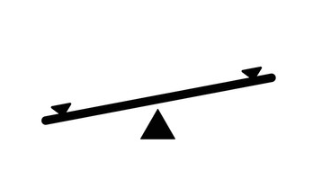
Free radical theory
Free radicals
Antioxidants
Oxidative damage in cells/ tissues
Oxidized proteins
Damage to mitochondria

Slide 45
Hayflick’s theory
Telomere – A Cap on Genome
With each division- the cap shortens
Reaches critical length
No further cell division

Slide 46
Recent advances

Slide 47
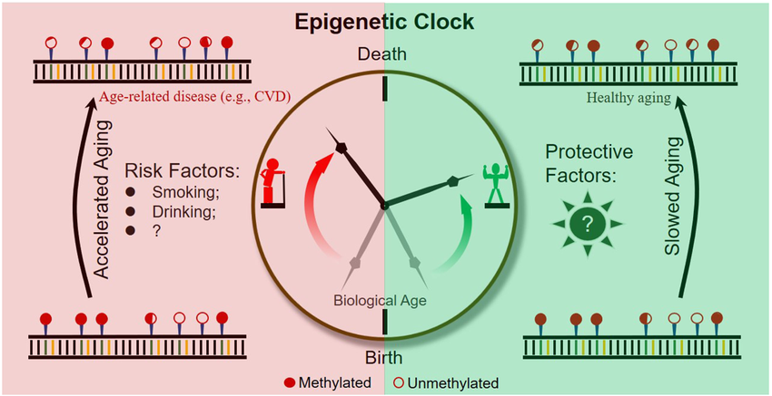
Epigenetic Clocks
Development of DNA methylation-based “epigenetic clocks” (Horvath clock, Hannum clock).
These predict biological vs chronological age and are more accurate than traditional markers.
Application: Used in clinical research for ageing interventions.

Slide 48
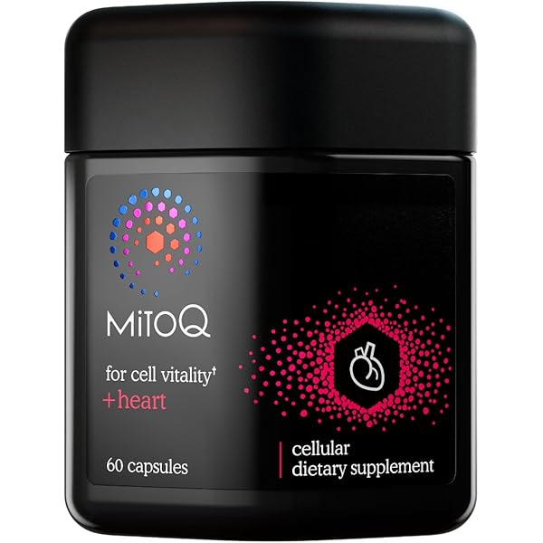
Mitochondrial Biology
Role of mitochondrial DNA mutations, fission-fusion imbalance, and mitophagy in ageing.
Advances in imaging show impaired mitochondrial dynamics → reduced ATP, increased ROS.
Mitoquinone mesylate (MitoQ) is a synthetic analogue of coenzyme Q10 which has antioxidant effects.

Slide 49
Proteo-stasis & Autophagy
Stem cell rejuvenation (iPSCs)
Gut microbiota diversity declines with age. (Rejunevating)
Senolytics: molecules that kill senescent cells

Slide 50
Thank You

